Slide 1
Self-induced Uniaxial Strain due to Interlayer Interaction in MoS₂
National Laboratory for Infrared Physics,
Shanghai Institute of Technical Physics, CAS,
Shanghai 200083, China
Ning Dai
Date: 2014.11.13

Slide 2
Outline
Graphene and layered transition metal
dichalcogenides (TMDs)
1
Preparation of monolayer MoS₂ by
vapor-solid-growth route
2
3
Tuning the phonons behaviors of MoS₂ by
Strain engineering
Self-induced Strain due to local van der
Waals-stacked interlayer interaction in MoS₂
4
5
Conclusions

Slide 3
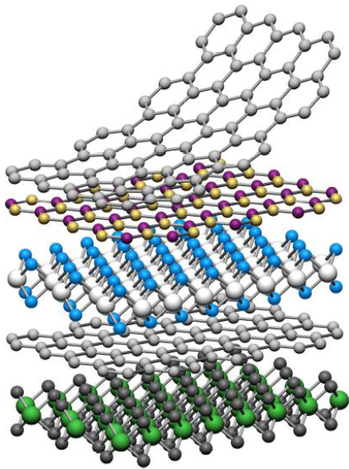
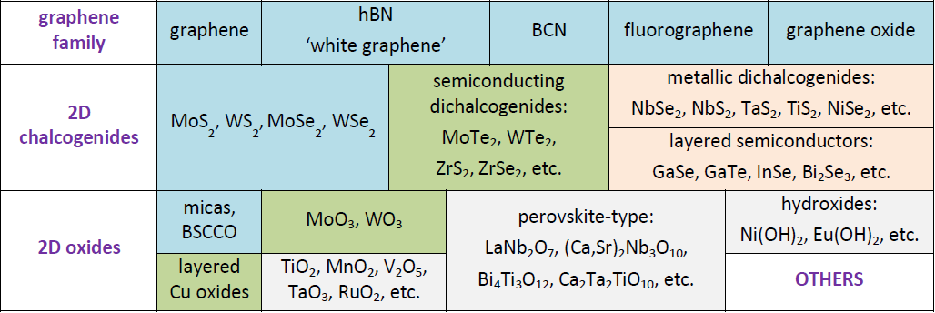
1. Graphene and layered transition metal dichalcogenides (TMDs)
Current 2D library
The thinnest two-dimensional (2D) crystal with exceptional electronic, optical and mechanical properties (e.g., graphene, MoS₂) due to its atomic-layer thickness and 2D morphology.
Nature 499, 419–425 (2013)

Slide 4
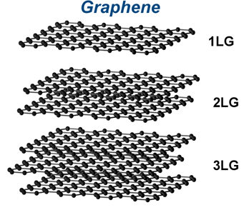
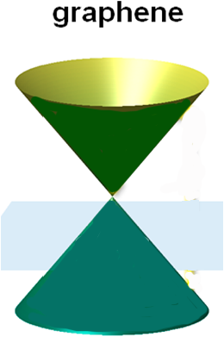
1.Graphene and layered transition metal dichalcogenides (TMDs)
Although graphene have extremely high carrier mobility, the gapless nature of graphene prevents the formation of a large potential barrier for charge separation and current rectification and retards its application in logic electronics.

Slide 5
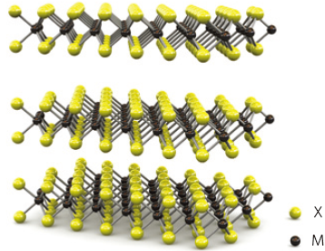
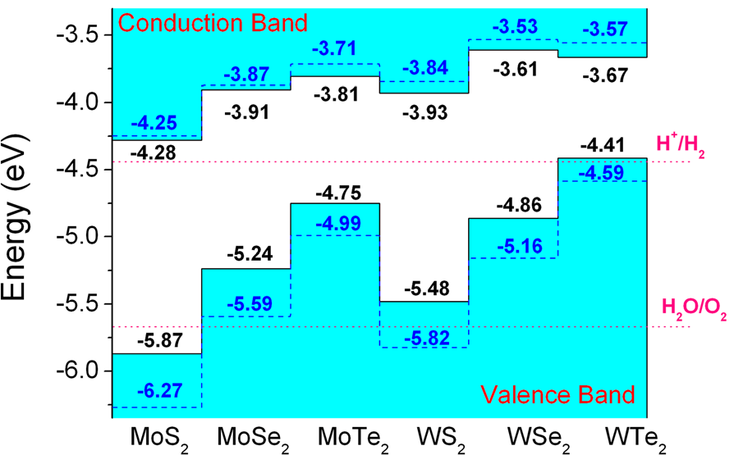
1.Graphene and layered transition metal dichalcogenides (TMDs)
monolayer
As the complementary materials to zero-bandgap graphene, TMDs are emerging as an exciting material system for a new generation of atomically thin optoelectronics, including photodetectors, ultrafast lasers, polarizers, touch panels and optical modulators.
Nature Nanotechnology 8, 497–501 (2013)
Science 340, 1311 (2013)

Slide 6
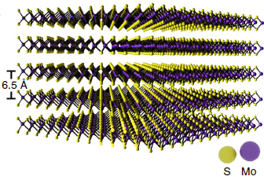
1. Graphene and layered transition metal dichalcogenides (TMDs)
Molybdenum disulfide, one of the most promising member of the TMDs family, monolayer MoS₂ consists of two planes of hexagonally arranged S atoms linked to a hexagonal plane of Mo atoms via covalent bonds and belong to point group D_{3h} without inversion symmetry. Bilayer MoS₂ is composed of two monolayer MoS₂ and belong to point group D_{6h} with inversion symmetry.

Slide 7
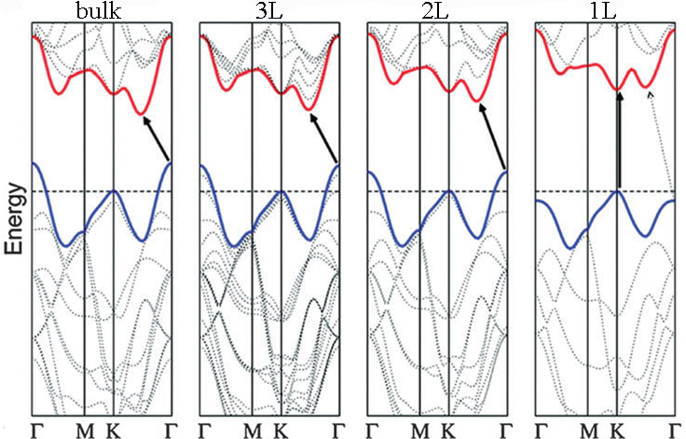
1. Graphene and layered transition metal dichalcogenides (TMDs)
indirect 1.2eV
direct 1.8eV
Bulk MoS₂ exhibits an indirect band gap of 1.2 eV, while monolayer MoS₂ has a direct band gap of 1.8 eV with enhanced photoluminescence.
Top-gated transistors based on single-layer MoS₂ flakes showed excellent on/off
current ratio of∼10⁸ and mobility of >200 cm²V⁻¹s⁻¹.

Slide 8
Outline
Graphene and layered transition metal
dichalcogenides (TMDs)
1
Preparation of monolayer MoS₂ by
vapor-solid-growth route
2
3
Tuning the phonons behaviors of MoS₂ by
Strain engineering
Self-induced Strain due to local van der
Waals-stacked interlayer interaction in MoS₂
4
5
Conclusions

Slide 9
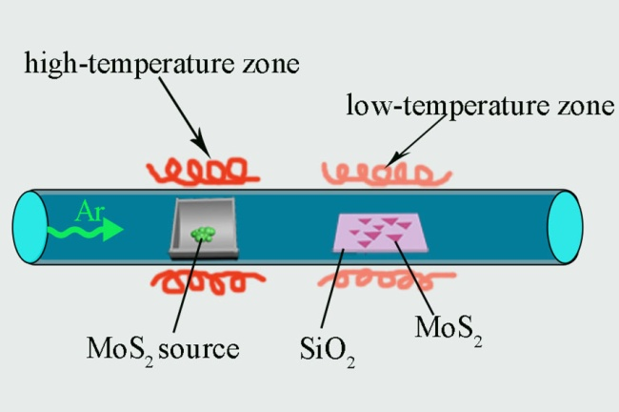
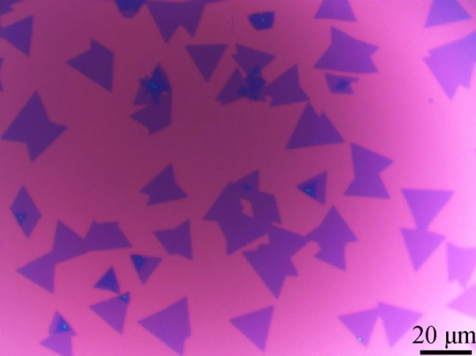
2. Preparation of monolayer MoS₂ by vapor-solid-growth route
growth process and optical image
K. N. Zhang, Y. Zhang, T. N. Zhang, W. J. Dong, T. X. Wei, Y. Sun, X. Chen, G. Z. Shen, N. Dai. Nano Res. DOI 10.1007/s12274-014-0557-1 (2014)

Slide 10
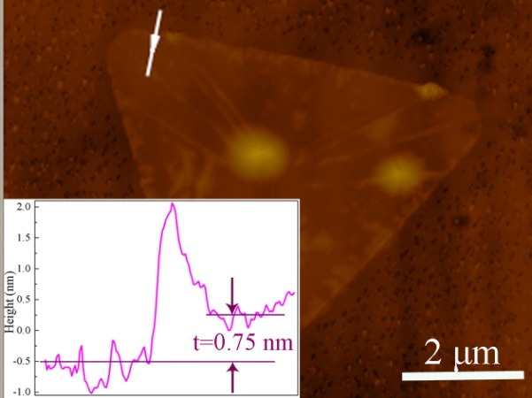
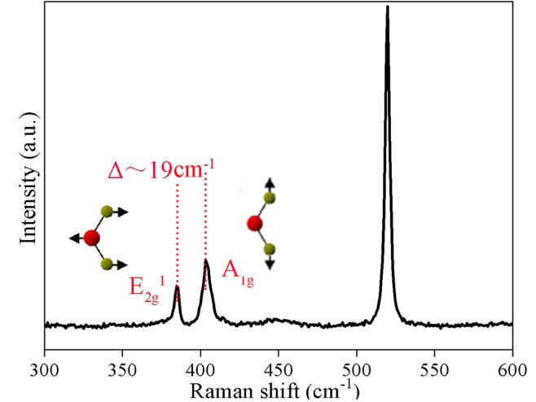
2. Preparation of monolayer MoS₂ by vapor-solid-growth route
AFM indicates the MoS₂ single layer, confirmed by the energy separation of the two MoS₂ Raman modes.

Slide 11
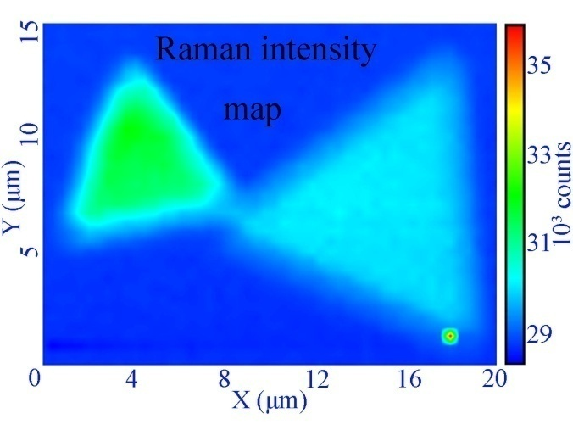
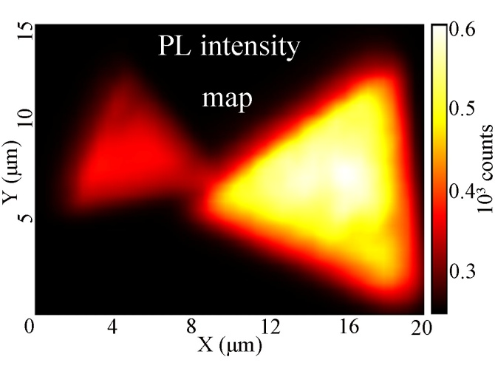
2. Preparation of monolayer MoS₂ by vapor-solid-growth route
Raman and PL intensities indicate the single layer and multilayer features

Slide 12
Outline
Graphene and layered transition metal
dichalcogenides (TMDs)
1
Preparation of monolayer MoS₂ by
vapor-solid-growth route
2
3
Tuning the phonons behaviors of MoS₂ by
Strain engineering
Self-induced Strain due to local van der
Waals-stacked interlayer interaction in MoS₂
4
5
Conclusions

Slide 13
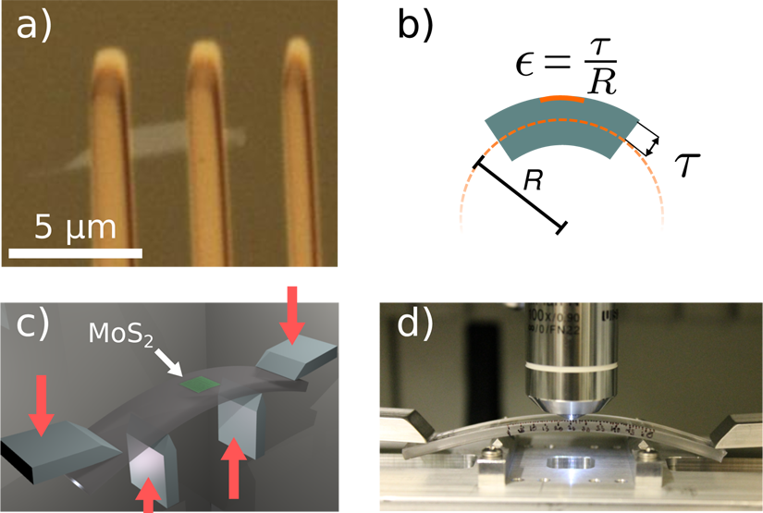
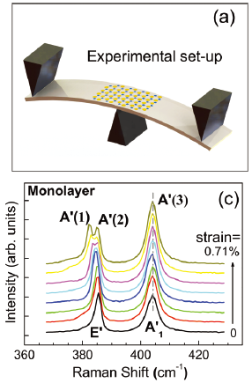
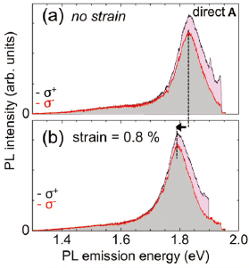
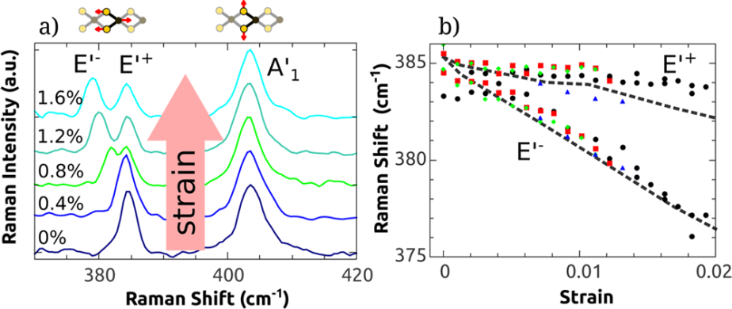
3. Tuning the phonons behaviors of MoS₂ by Strain engineering
Phys. Rev. B 88, 121301 (2013)
Nano Lett. 13, 3626-3630 (2013)
Strain engineering is a powerful tool for tuning the behaviors of electrons and phonons in layered semiconductor materials (e.g., MoS₂ or graphene).

Slide 14
Outline
Graphene and layered transition metal
dichalcogenides (TMDs)
1
Preparation of monolayer MoS₂ by
vapor-solid-growth route
2
3
Tuning the phonons behaviors of MoS₂ by
Strain engineering
Self-induced Strain due to local van der
Waals-stacked interlayer interaction in MoS₂
4
5
Conclusions

Slide 15
4. Self-induced Strain due to Local van der Waals-stacked Interlayer Interaction in MoS₂
Local van der Waals-stacked MoS₂ samples: optical images and schematic feature.

Slide 16
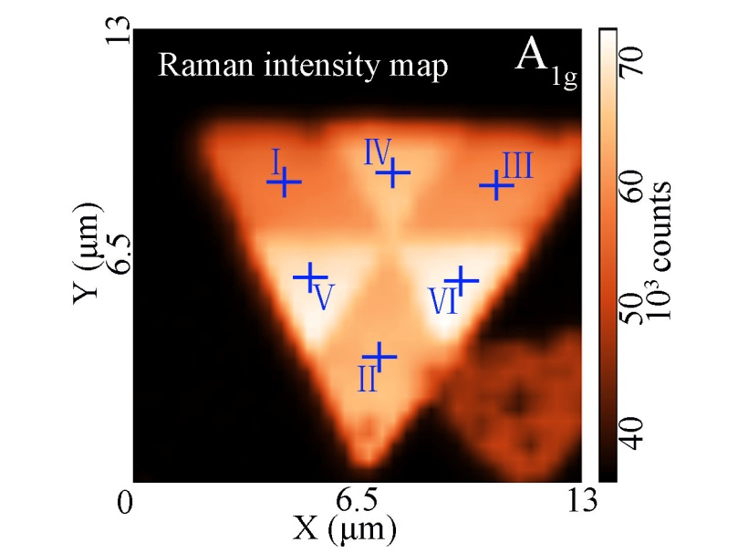
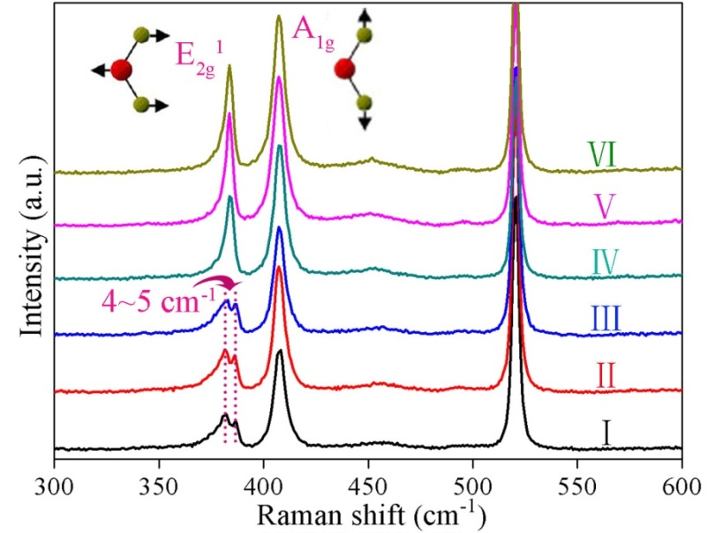
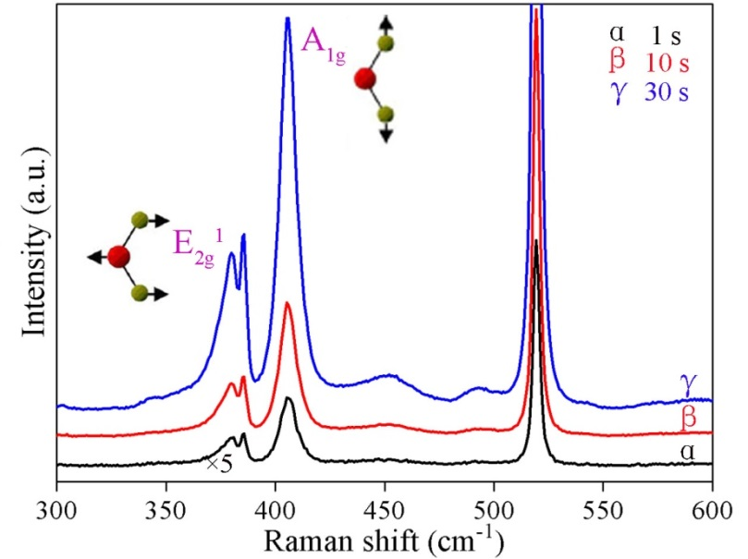
4. Self-induced Strain due to Local van der Waals-stacked Interlayer Interaction in MoS₂
In the stacked region, the E_{2g}¹ in-plane Raman mode in single layer part show 4~5 cm⁻¹ split, indicating the formation of strain.

Slide 17
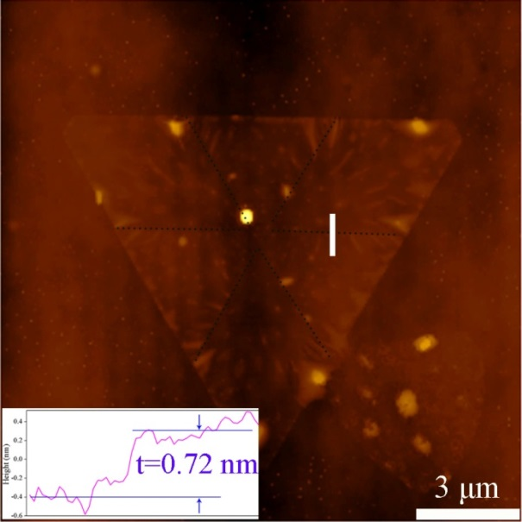
4. Self-induced Strain due to Local van der Waals-stacked Interlayer Interaction in MoS₂
The AFM image and line scan confirm the stacking layer is a single MoS₂ layer.

Slide 18
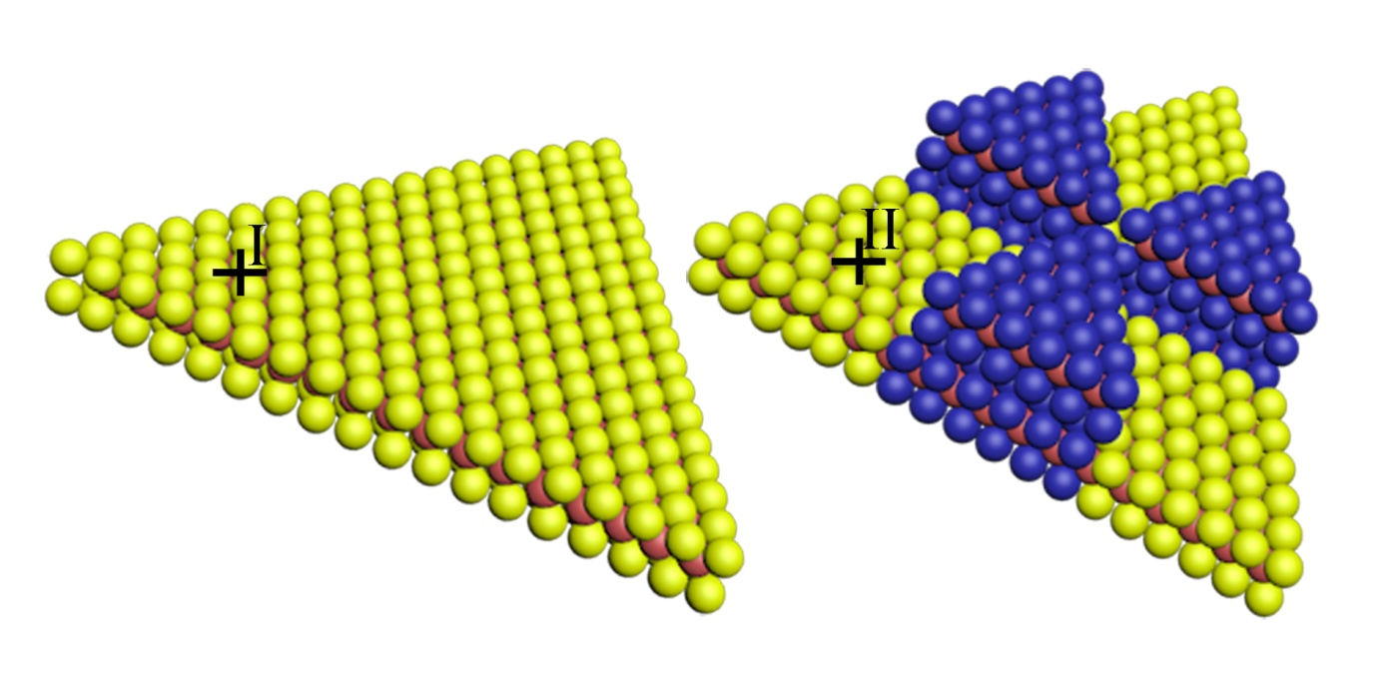
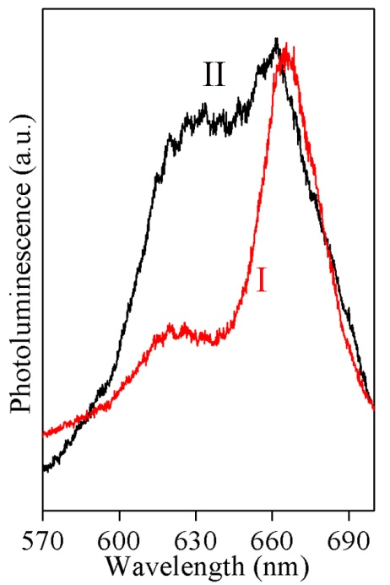
4. Self-induced Strain due to Local van der Waals-stacked Interlayer Interaction in MoS₂
Schematic contrast between monolayers with and without local stacked semi-monolayers.PL spectra of an individual monolayer MoS₂ and monolayer without local stacked semi-monolayers. The peak of line II blue shifts.

Slide 19
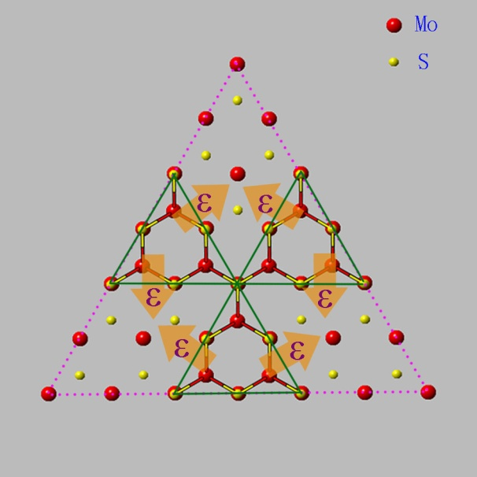
4. Self-induced Strain due to Local van der Waals-stacked Interlayer Interaction in MoS₂

Slide 20
4. Self-induced Strain due to Local van der Waals-stacked Interlayer Interaction in MoS₂
We believe the lateral lattice difference between monolayer and bilayer lead to the split of E_{2g}¹ Raman mode. When a local monolayer is placed on one monolayer, the lateral lattice of the monolayer region must match and coordinate with the crystalline symmetry of the MoS₂ bilayer. As a result, the stacking of two adjacent local monolayers might induce uniaxial compressive strain.
In the absence of strain, E_{2g}¹ is two-dimensional degenerate mode. As uniaxial strain is applied to the monolayer, it split into two modes as the degeneracy is lifted.

Slide 21
4. Self-induced Strain due to Local van der Waals-stacked Interlayer Interaction in MoS₂
van der Waals-stacked could change the intralayer bonding and/or the presence of Coulombic interlayer interactions in van der Waals-stacked MoS₂ were approved in many literatures.
ACS Nano 4, 2695-2700 (2010)
Adv. Funct. Mater. 22, 1385-1390 (2012)
Phys. Rev. B 87, 115413 (2013)
The lateral lattice changed also observed for dispersed single layers compared to its bulk value.
Phys. Rev. B 28, 2237-2239 (1983)
Whether the Self-induced Strain will introduced by van der Waals-stacked Interlayer Interaction ?

Slide 22
Outline
Graphene and layered transition metal
dichalcogenides (TMDs)
1
Preparation of monolayer MoS₂ by
vapor-solid-growth route
2
3
Tuning the phonons behaviors of MoS₂ by
Strain engineering
Self-induced Strain due to local van der
Waals-stacked interlayer interaction in MoS₂
4
5
Conclusions

Slide 23
5. Conclusions
Local internal van der Waals-stacked interlayer interaction is responsible for uniaxial strain with the change and deformation of local intralayer bonding in MoS₂, which benefits our understanding of interlayer interactions in layered MoS₂ materials. The demonstration and discovery of self-induced intralayer strains by local van der Waals-stacked interlayer interaction will create new opportunities for promoting strain engineering, tunable functionalities and the fundamental phenomena of two-dimensional layered stacked constructions.

Slide 24
小组成员：陈鑫、孙艳、邓惠勇、胡古今、胡淑红
学生：张克难、张云、张天宁、王洋、王超

Slide 25
Thank You !

